Slide 1




‘Adding fun to your life’
Tech
अभिव्यक्ति
Shafty
IKeyFlex
Ladders N Snakes
FlyBy
Slither
Guess The Number
A Project Expo by CSE 2022 Batch at Chitkara university
A Tech Track Series Initiative by
OPEN SOURCE CHANDIGARH
GAME ISLAND
Team Details:
Aryan Singh 2210991389
Arsh Jain 2210991361
Aryan Kaushal 2210991382
Mentor : Dr. Anshu Singla

Slide 2
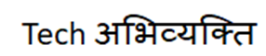
Brief Overview
Shafty
IKeyFlex
Ladders N Snakes
FlyBy
Slither
Guess The Number
Bored? How about refreshing your mind?
Here we are with our “Game Island”
having a bunch of games which will
give you an exciting and thrilling
experience.
Written using 4896 lines of code
Minimalistic and user friendly GUI
Sign up through OTP Verification
RTDBMS – Firebase
ML Model to predict future activity.
Major modules - customtkinter, pygame, pyrebase, Threading, os, matplotlib, json, ast, smtplib etc.

Slide 3
Table of Contents
Problems
01
Solutions
Implementation
02
03
04
Results
05
Reference
The problem that the project aims to solve
how to approach the problem and solve it.
Detailed explanation of implementation process with results
Some results that’s matter
Future Scope
Let’s talk about it
06
Some references about our project

Slide 4
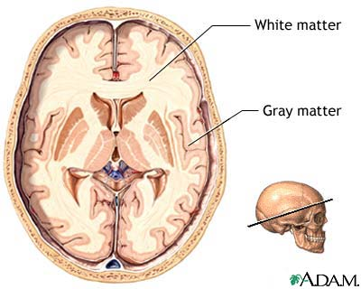

01
Problems
The problem that the project aims to solve

Slide 5
Problems
Stress and Anxiety
Lack of concentration
Bad mental health
Lack of Grey Matter
02
Causes lack of muscle control
Memory issues

Slide 6
02
Solutions
how to approach the problem and solve it.

Slide 7
Solutions
Good Reflexes And Coordination
1
01
Help to work on your reflexes and coordination
User Friendly
2
02
User friendly game for players
All games in
single App
3
03
compiled some great games in a single hub
Not So Complicated
4
04
Learning with ease

Slide 8
03
Implementation
Sign up
&
Create Password
Sign in
&
Forgot
Password
Detailed explanation of implementation process.
App Drawer
&
Dashboard

Slide 9
ROADMAP TO THE APP DRAWER
Sign up
&
Create Password
Sign in
&
Forgot
Password
App Drawer
&
Dashboard

Slide 10
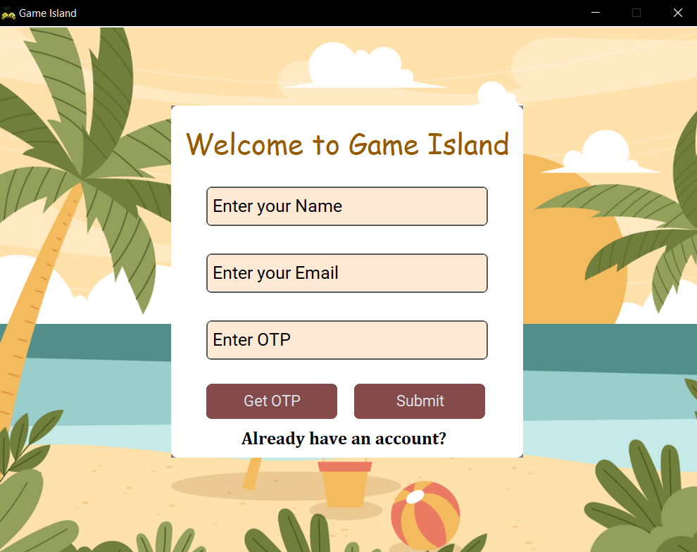
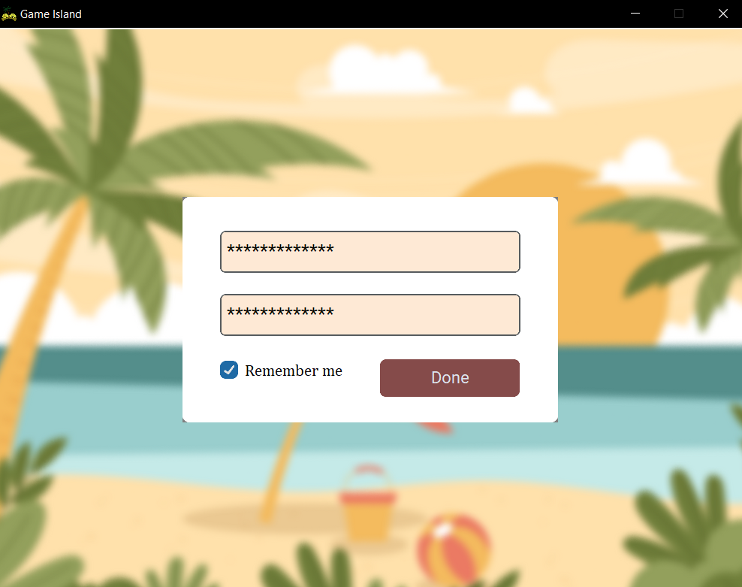
Sign up & Create Password
Create password
Sign up page

Slide 11
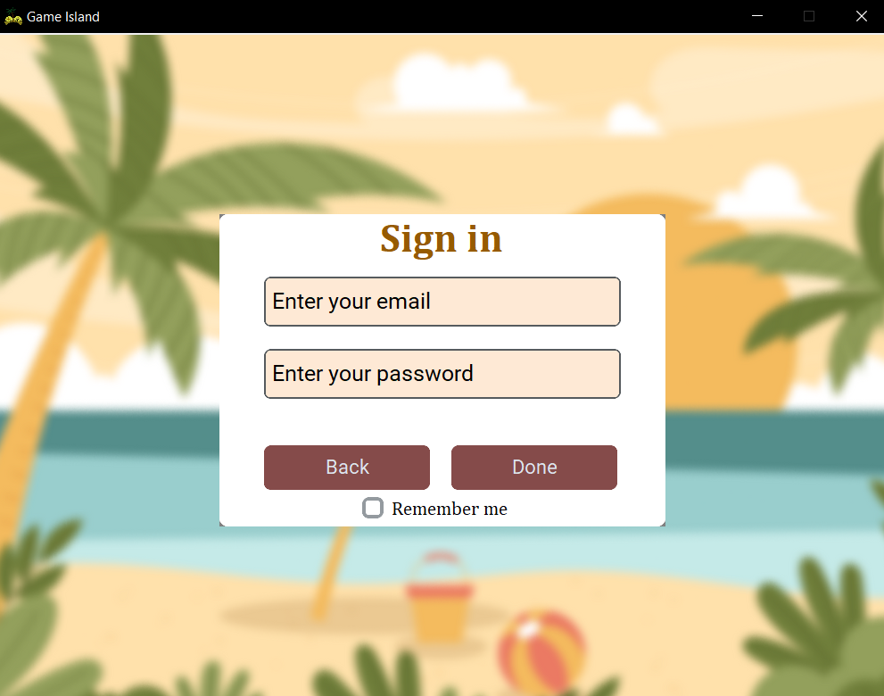
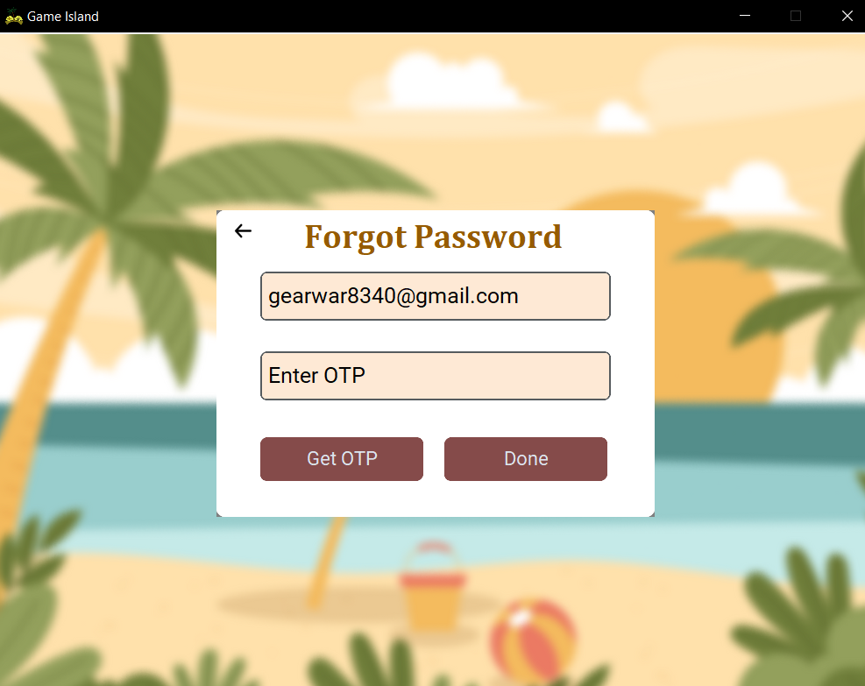
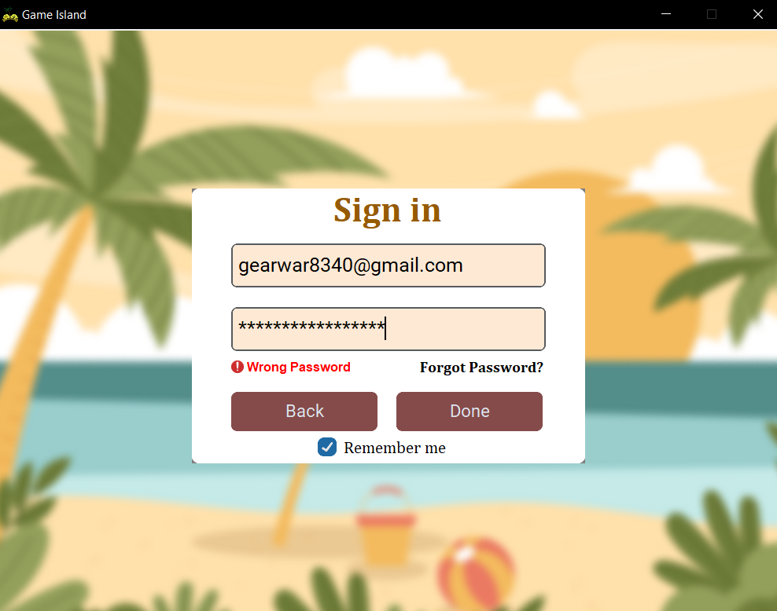
Sign in & Forgot Password
Oops forgot your password!!
Sign in page
Generate new Password using OTP

Slide 12
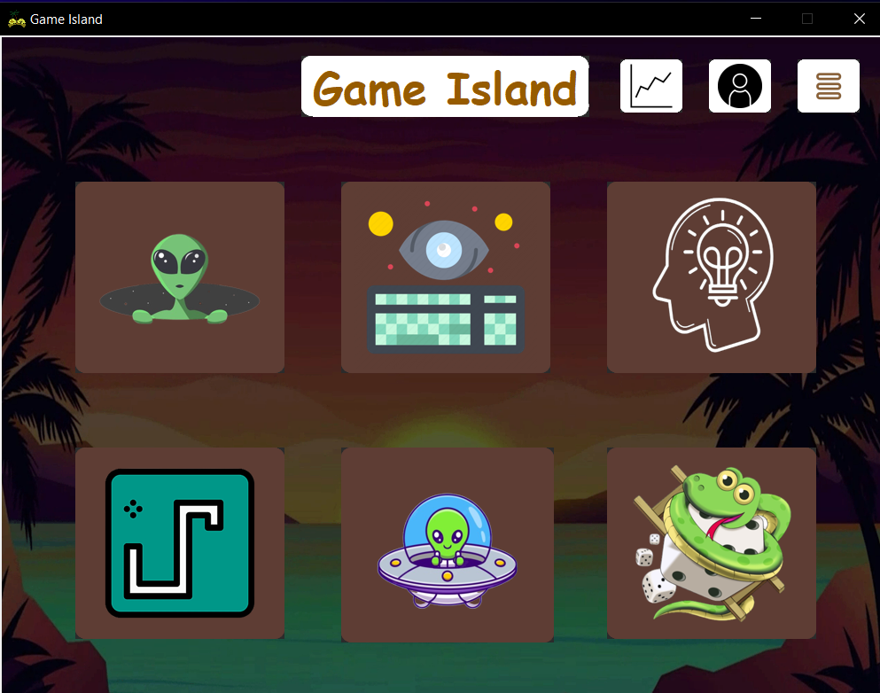
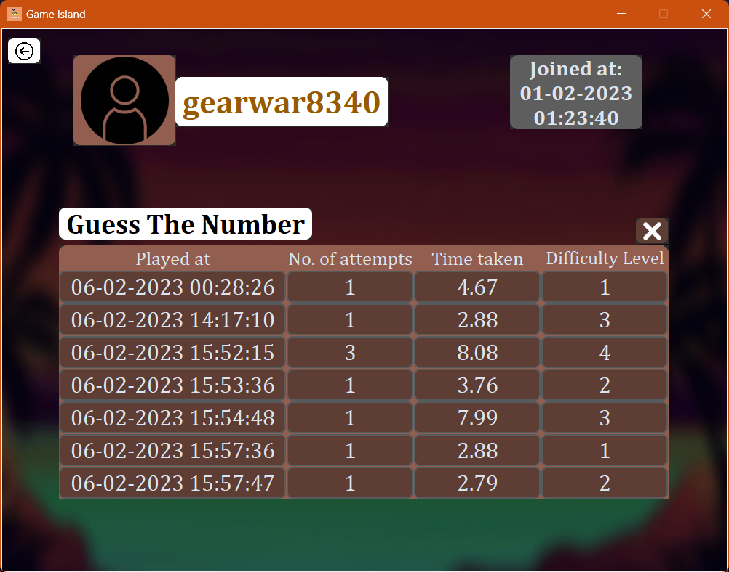
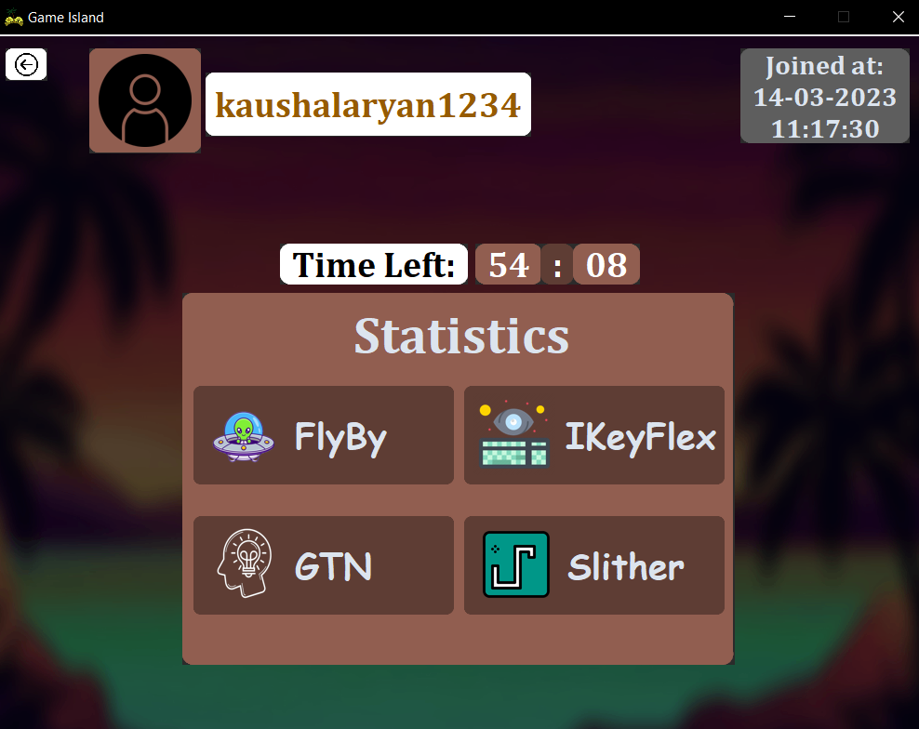
App Drawer & Dashboard
Dashboard
App Drawer
Stats are maintained using RTDBMS
(Firebase)

Slide 13

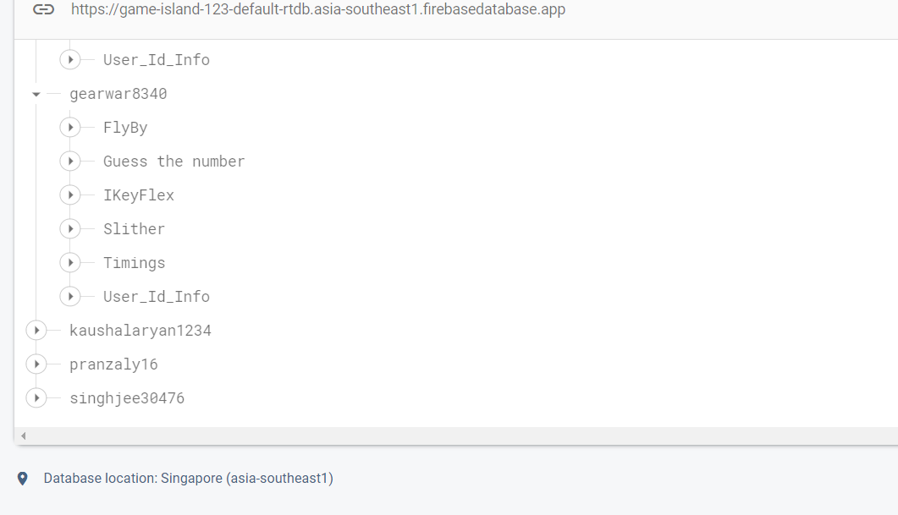
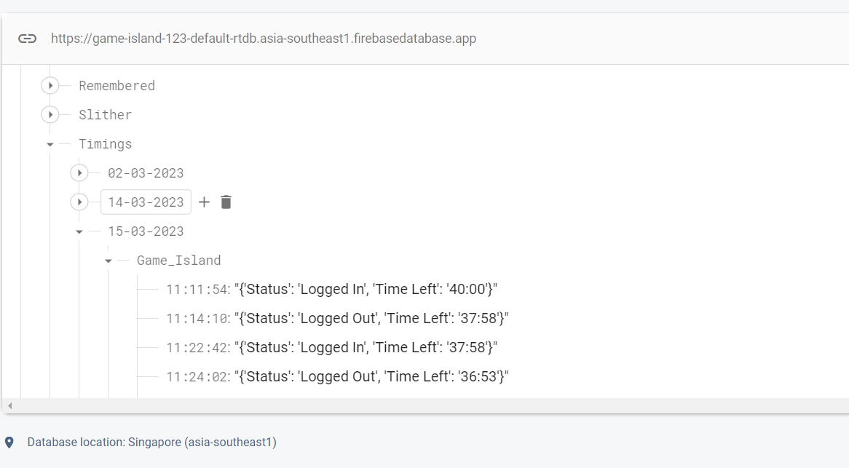
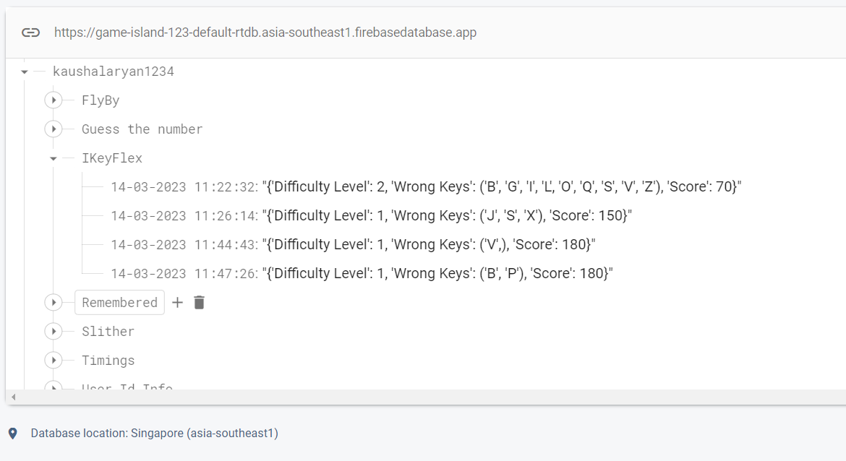
IKeyFlex
Test your reflexes
RTDBMS(Firebase)
Game Data
User Data
Login and Logout Time

Slide 14
IKeyFlex
Test your reflexes

Slide 15
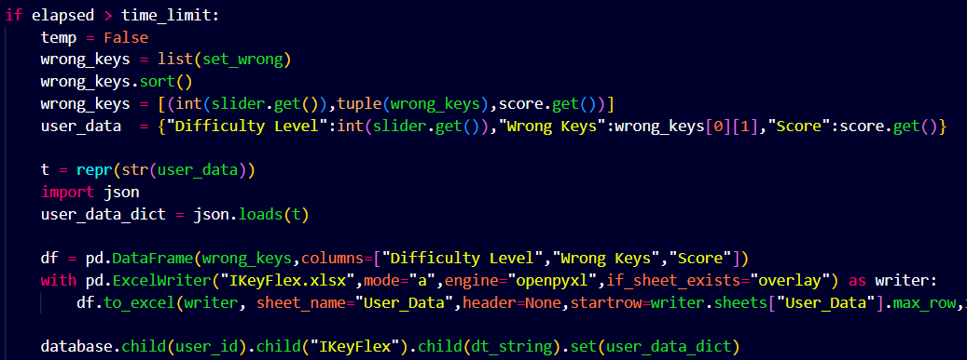
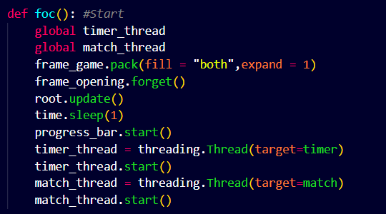
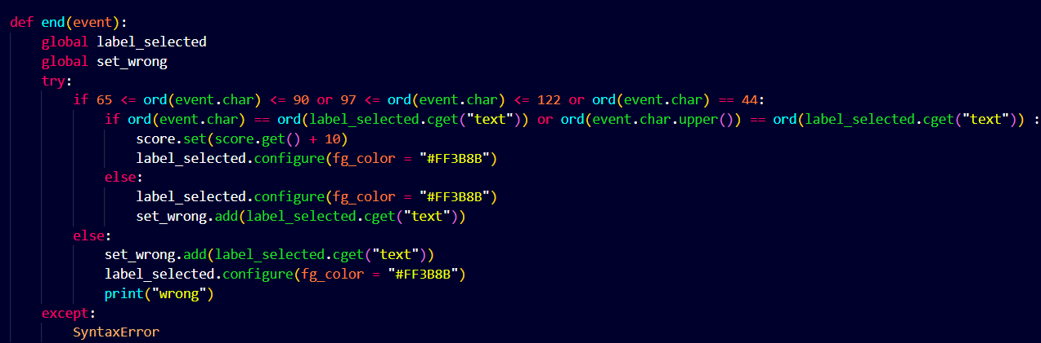
Key points
IKeyFlex is a great way to improve hand-eye coordination and reaction time..
It can help to improve typing speed and accuracy, as well as concentration power.
The objective is to press keys on your keyboard in response to visual clues.
it's important to stay focused and take your time. Don't rush through the game, as this can lead to mistakes
Ladders and snake

Slide 17
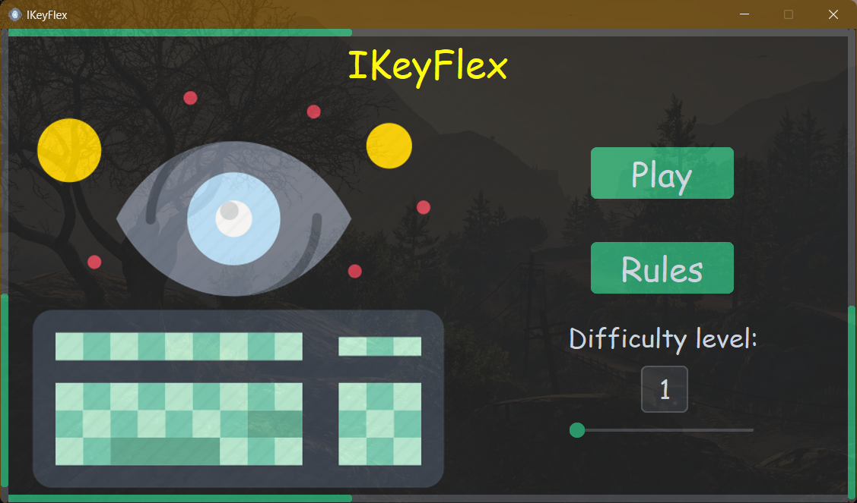
Work Flow
Select The Difficulty Level
Play Button
Press the keys on keyboard which are highlighting on the screen
Starting Screen
End
Display The
score

Slide 18
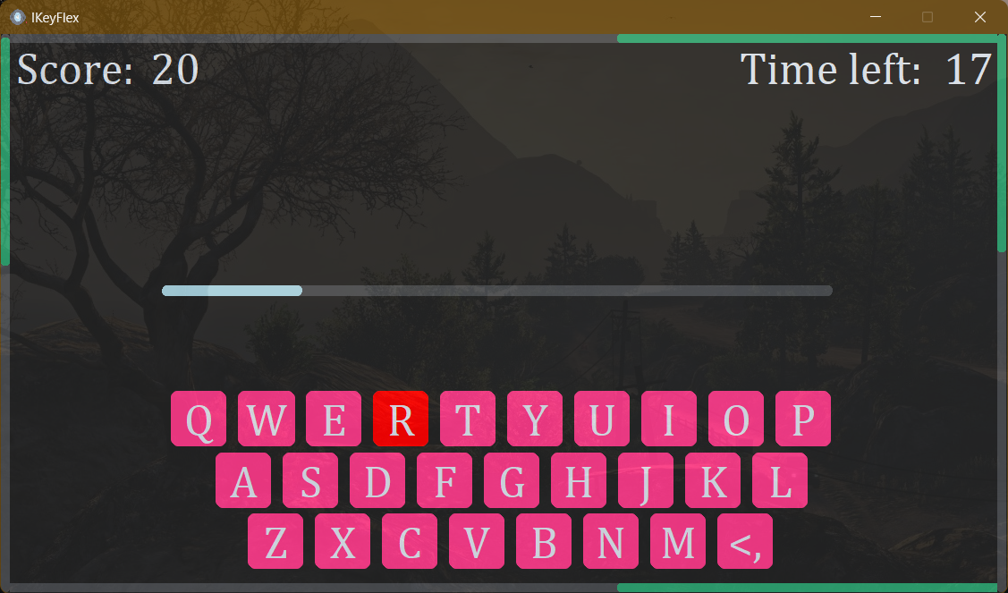
IKeyFlex

Slide 19
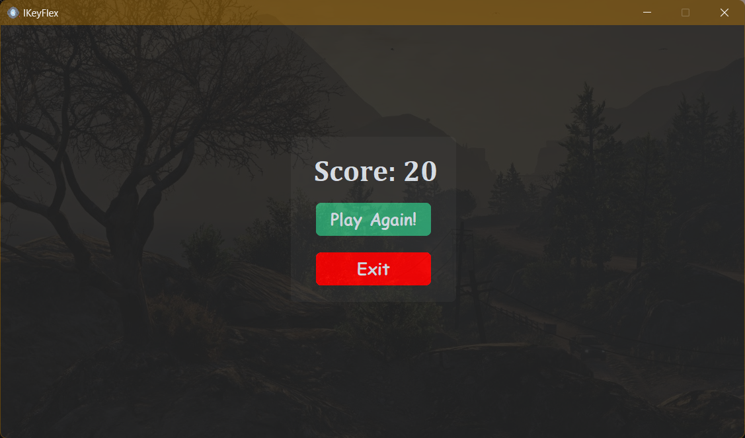
IKeyFlex

Slide 20
Shafty
Welcome to the mysterious world
IKeyFlex

Slide 21
Shafty
Welcome to the mysterious world

Slide 22
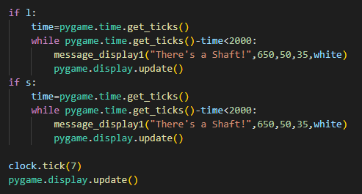
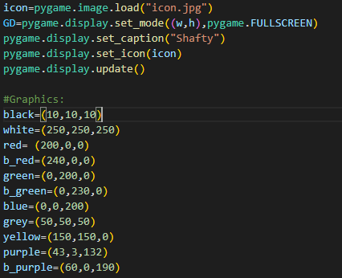
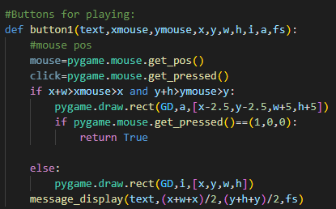
Key points
Shafty is a game of luck and can be played by people of different age.
This game is a great way to entertain family and friends.
In this game the player has to move his alien from 100 to 1 and has to pass through the shafts and win the game.
In this game the board have shafts at different places, if u land on then u will be redirected to random position on the board.

Slide 24
Work Flow
START
Give dice to next player
Choose Player
Player
Player
Place on random block
Roll Dice
Move To Roll Position
No
yes
Check If Landed On shaft
Check If You The Last Block
You Are The Winner
End
No
yes

Slide 25
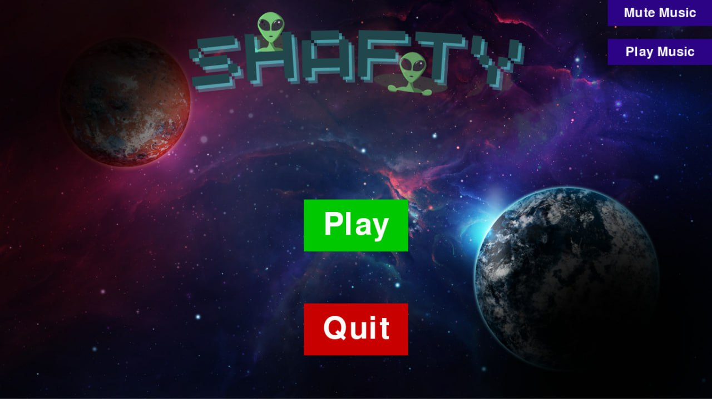
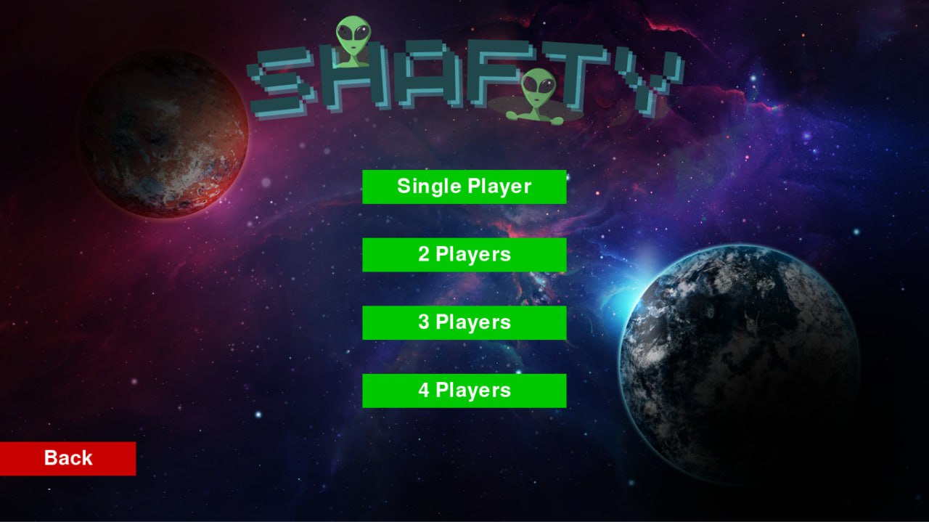

Shafty

Slide 26
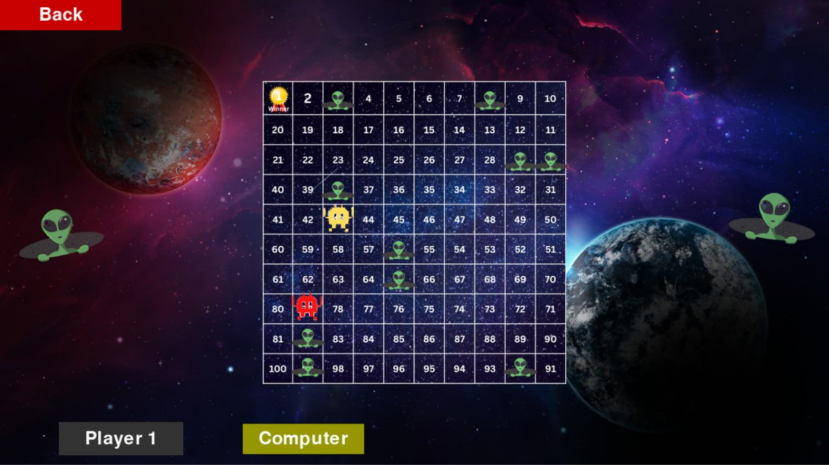
Shafty

Slide 27

Shafty
FlyBy
Try not to clash…

Slide 28
FlyBy
Try not to clash…

Slide 29
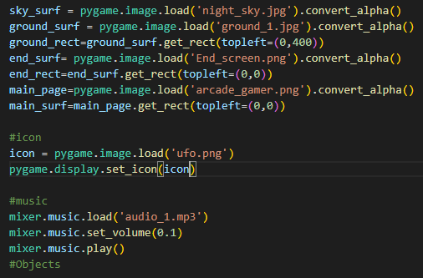
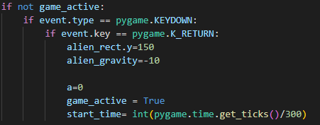
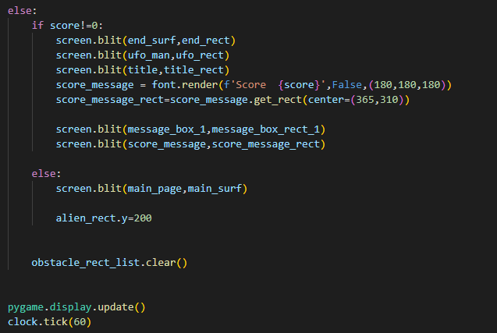
Key points
FlyBy game is a side-scrolling, 2D game where the player controls a small UFO as it navigates through a series of meteoroids.
The goal is to fly the UFO through the meteoroids without hitting them and score as many points as possible.
it's important to stay focused and take your time. Don't rush through the game, as this can lead to mistakes
This is a fun game for the people who love to enjoy between work, its good to have a break between so much of work.

Slide 31
Work Flow
yes
UFO survives obstacle
And remains in screen
UFO generation
Obstacle
generation
Obstacle are generated and shift left
Start
Button Input
No
GAME OVER
Display score

Slide 32
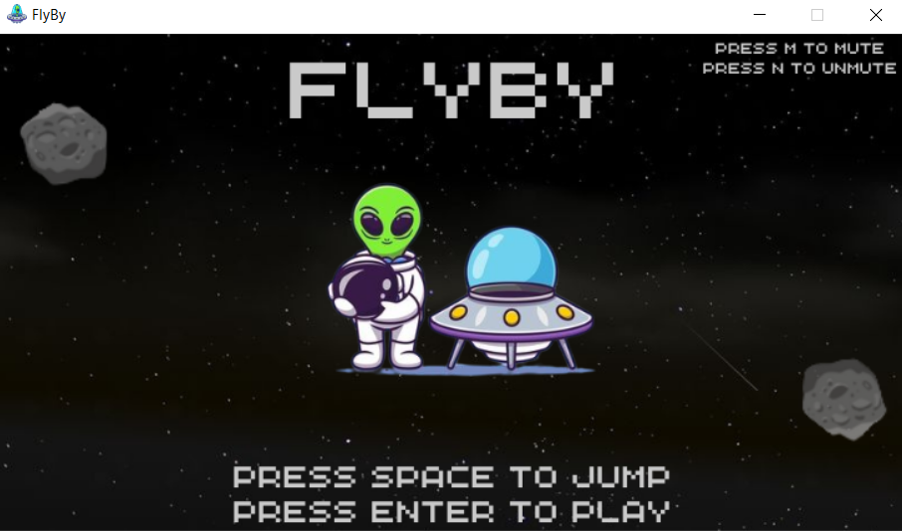
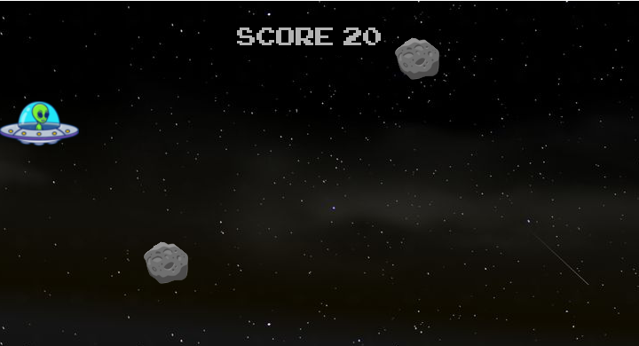
FlyBy

Slide 33
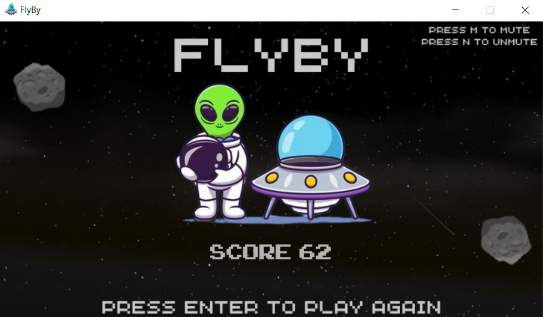
FlyBy

Slide 34
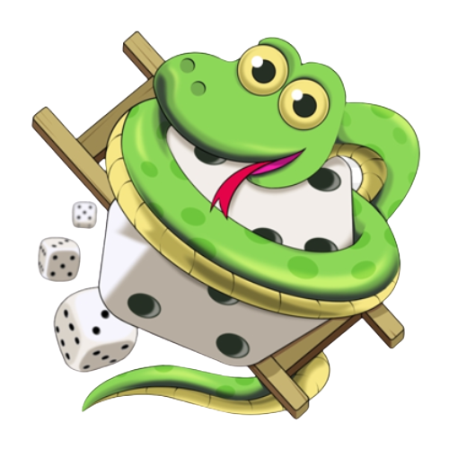

FlyBy
Guess The Number
Ladders N Snakes
Slither

Slide 35


ML Model
Time Limit
Guess The Number
Ladders N Snakes
Slither
Any Many More…

Slide 36
New Features
Time Limit
ML Model

Slide 37
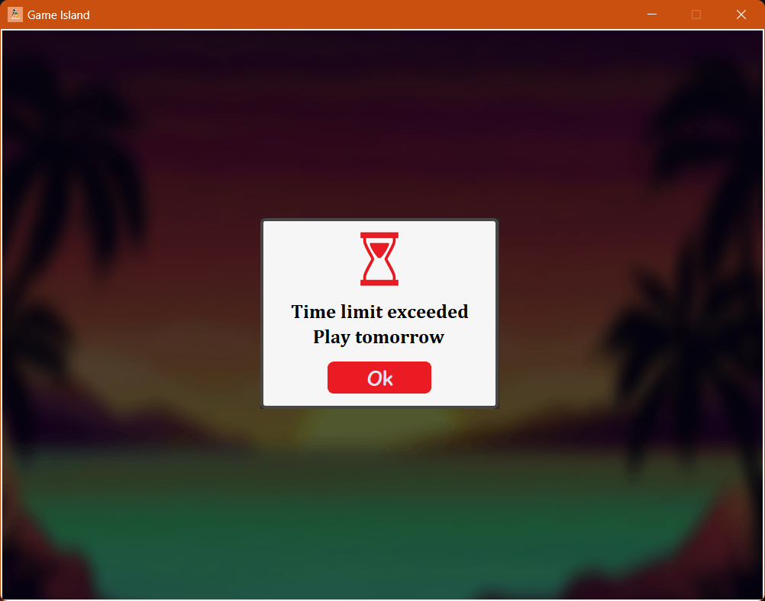
Time Limit
Time Limit
ML Model
A Time Limit of 60 Minutes is imposed to restrict the user to get addicted to the game and use it for stress reliving only.

Slide 38
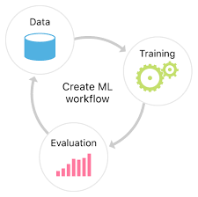
Time Limit
ML Model
ML Model
Machine Learning model tracks, analyses and predicts user's playing pattern.

Slide 39
Results
04
Some results that matters

Slide 40
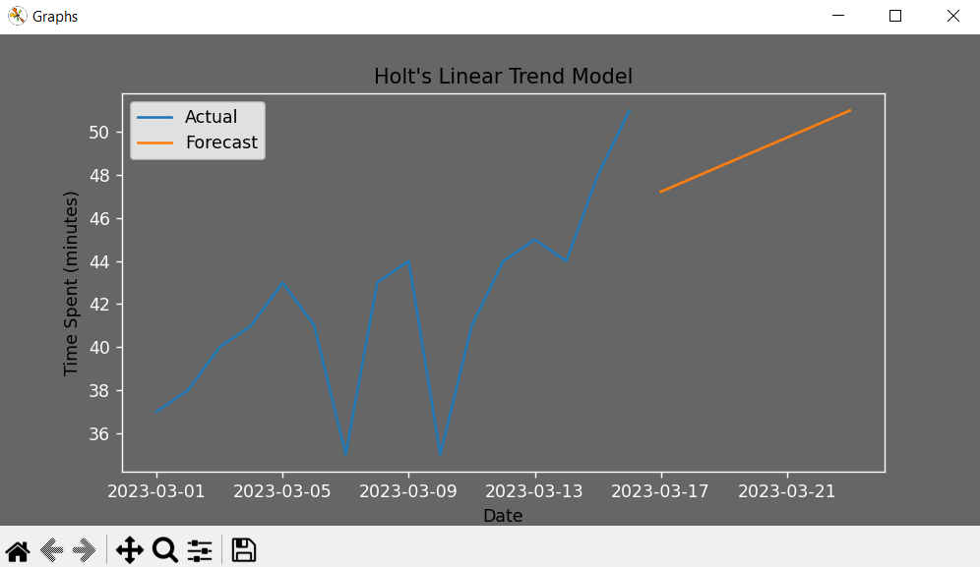
Results
05
Machine Learning model tracks, analyses and predicts user's playing pattern.
This ML model tracks recent 15 days data of user and show their upcoming 7 days forecast.

Slide 41




05
Future scope
Let’s talk about it
New Games
Mindfulness
sessions

Slide 42
FUTURE SCOPE
06
Exploring the Boundless Possibilities of Game Island
New Games
Mindfulness
sessions

Slide 43
06
References
Some references about our project

Slide 44
References
https://www.geeksforgeeks.org/introduction-to-pygame/
https://github.com/TomSchimansky/CustomTkinter/tree/master/examples
https://www.pygame.org/docs/
https://docs.python.org/3/library/tkinter.html
https://www.canva.com/
https://www.remove.bg/
https://www.resizepixel.com/edit
https://pandas.pydata.org/docs/
https://github.com/thisbejim/Pyrebase/
https://pypi.org/project/cryptography/

Slide 45
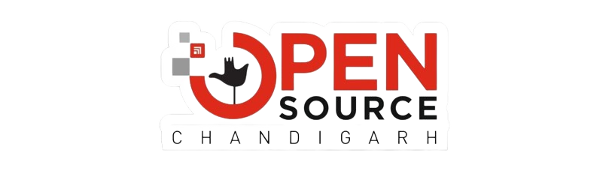
THANKS
AN OPEN SOURCE CHANDIGARH INITIATIVE

